Slide 2
What is a Local Place Plan?
A new mechanism introduced by the Planning (Scotland) Act 2019, for communities to shape how land should be used in their area.
Local Place Plans (LPPs) can identify areas of potential change, promote improvements, prioritise areas of vacant or derelict land for new uses and activities and propose building and land uses. LPPs can also consider the local economy, social considerations and health outcomes.
Local Place Plans are important community led projects that, once registered by the local council can become important considerations in planning decisions and can support the local authority and community organisations in funding applications, by showing a clear, cohesive strategy, supported by the community.
This LPP has also been supported by Glasgow City Council, who have funded development of the plan, among a number city-wide, through their Place Fund.
The wider area for this LPP includes the respective Community Council neighbourhoods, but the LPP project area will focus on the spaces around Queen’s Park, including civic space, land and buildings that connect the Park and neighbouring communities.

Slide 3
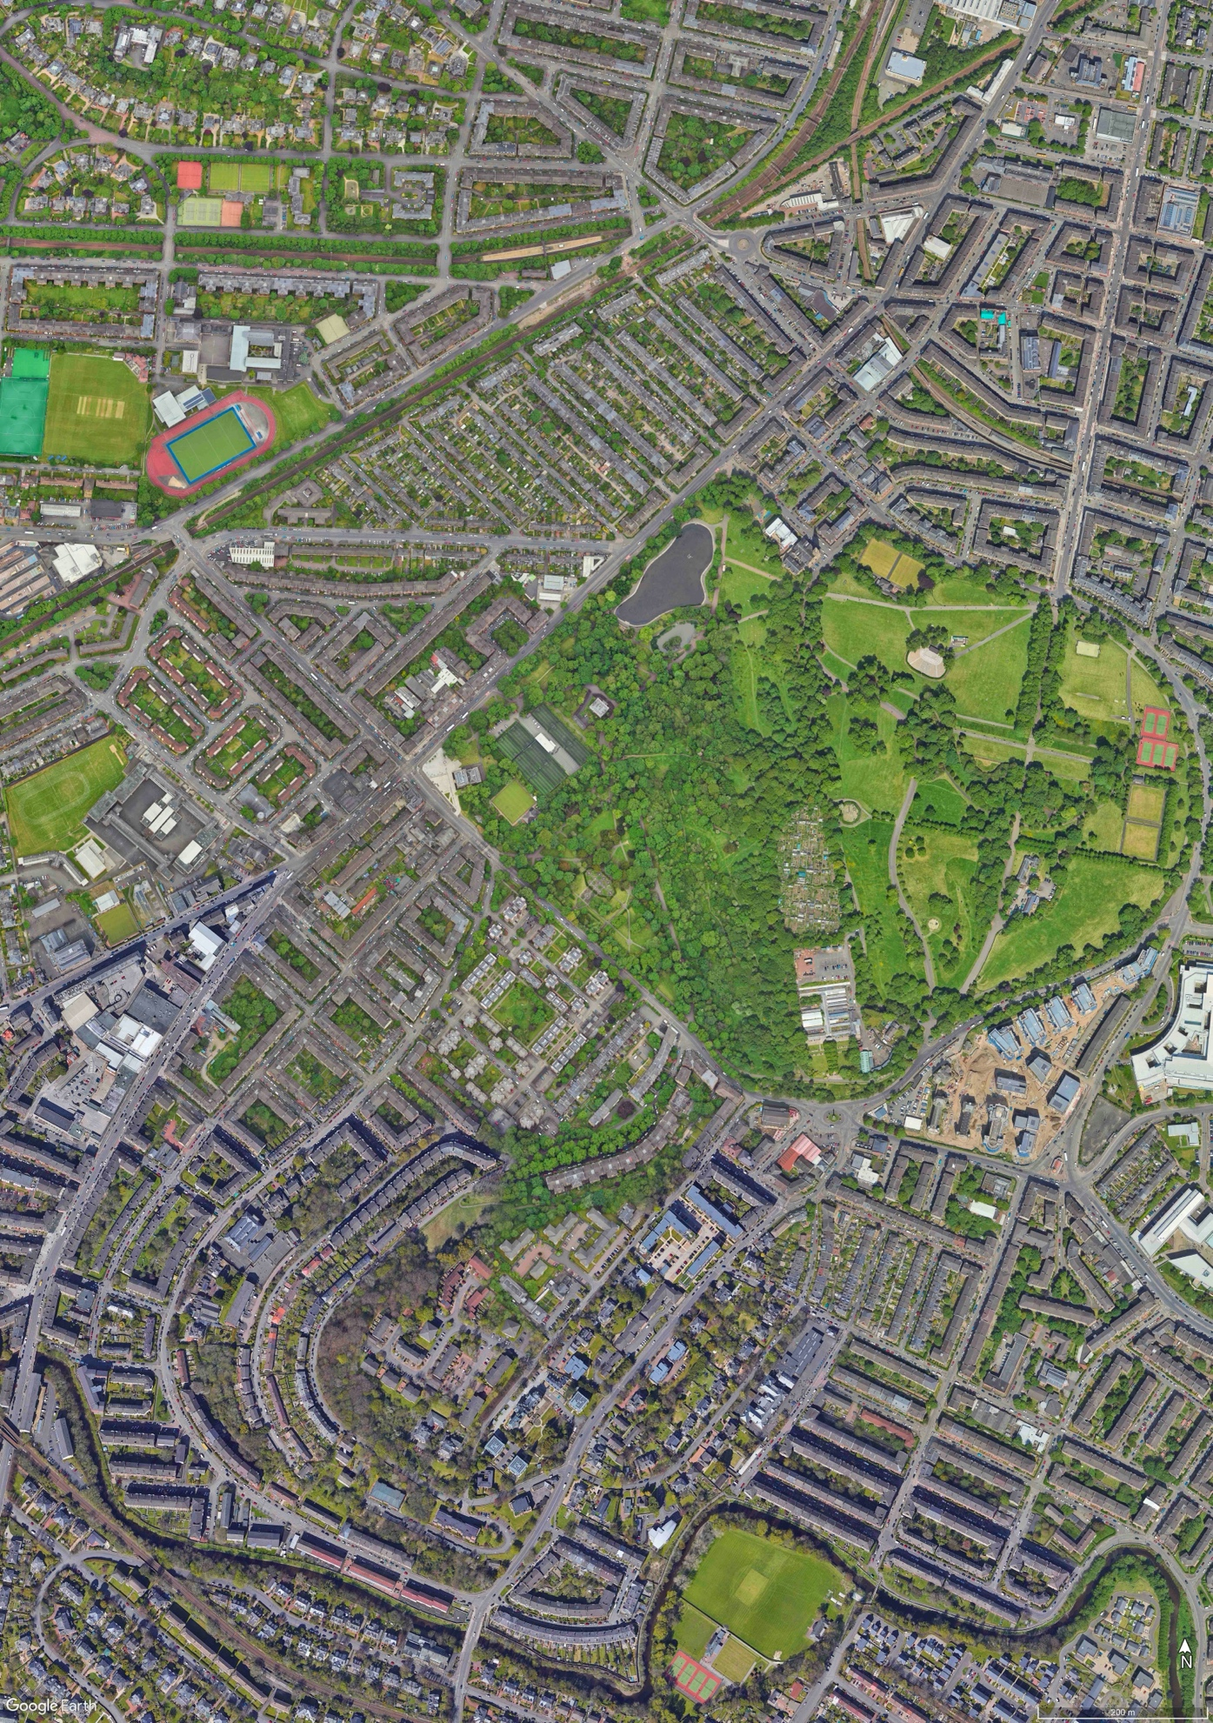
QPN – Our LPP study area
The LPP will draw on the results of extensive consultation exercises (already completed, recently undertaken and planned)
Queen's Park and buildings located within or near it (i.e. including the QP glasshouses, the Civic square adjacent to Langside Halls)
The LPP will build on the results of the work commissioned by Queen's Park Working Group (QPWG).

Slide 4
QPN – Our Values
collaborative
forward-looking
positive
diverse/multicultural
empowering
engaged
realistic
keeping it local

Slide 5
QPN - Local People Leading - Our 17 local stakeholders
Battlefield Community Project
Clyde College Student Association
Crosshill & Govanhill Community Council
Friends of Queen's Park
Glad Foundation
Greater Govanhill CIC
Inhouse Events CIC
Langside, Battlefield & Camphill Community Council
Langside Community Heritage
Langside Halls Trust
Mount Florida Community Council
MyShawlands
Shawlands Academy
Shawlands & Strathbungo Community Council
South Seeds
SRUC at Queen’s Park
Strathbungo Society

Slide 6
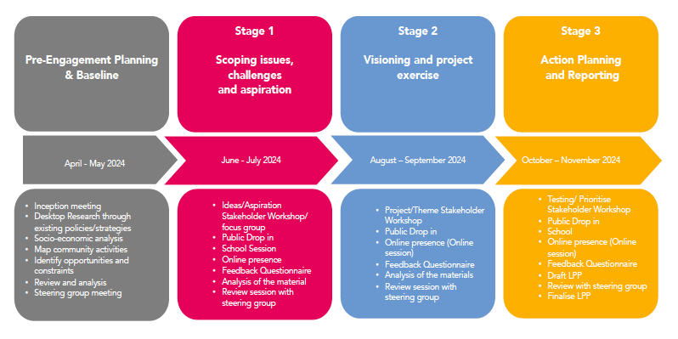
KMA – Kevin Murray Associates – Glasgow consultancy for planning, regeneration and urban design

Slide 7
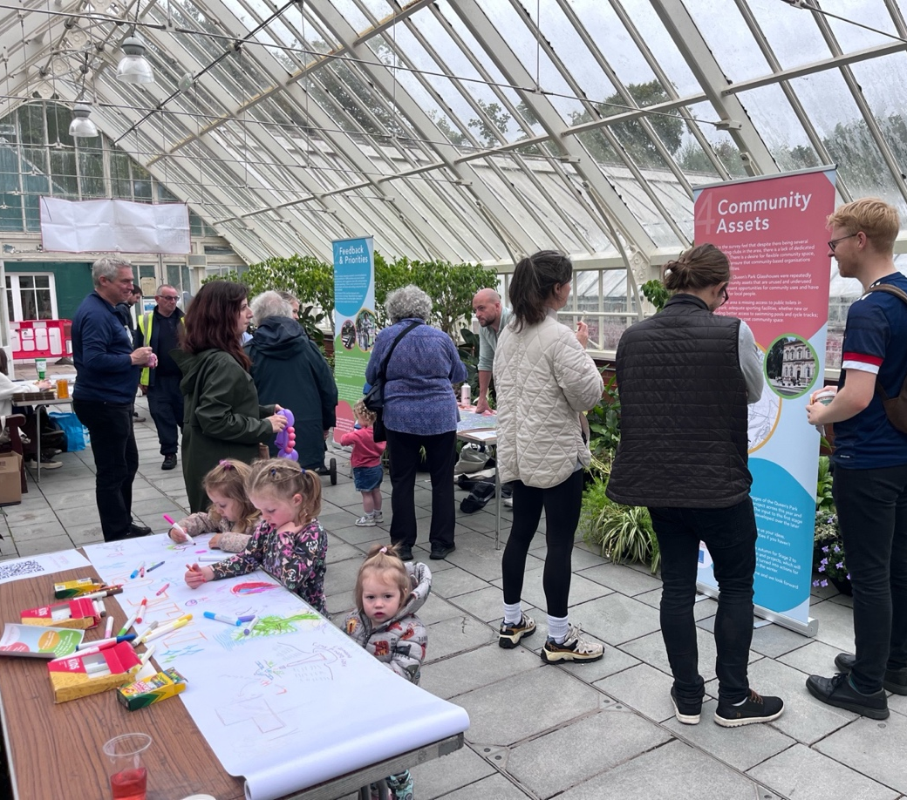
Consultation process Stage 1
May – August
Stakeholder workshop
Public engagement events – Shawlands Academy, Battlefield Street Party, Shawlands Farmers’ Market, Bungo in the Back Lanes, Govanhill Festival
Online survey, promoted at cafés, shops, libraries, local markets, Queen’s Park Arena – 309 responses
Community drop-ins – Civic Square, Glasshouses
Accessibility visit with Glasgow Disability Alliance

Slide 8
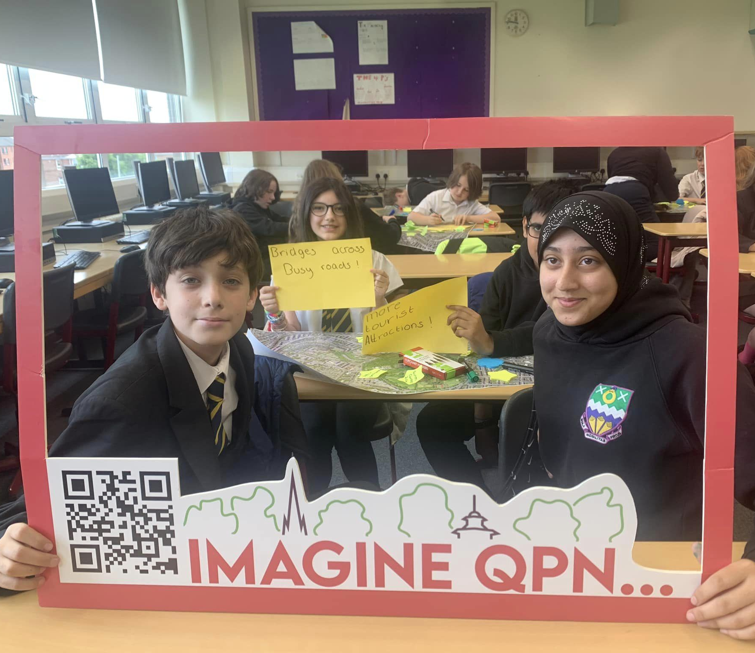
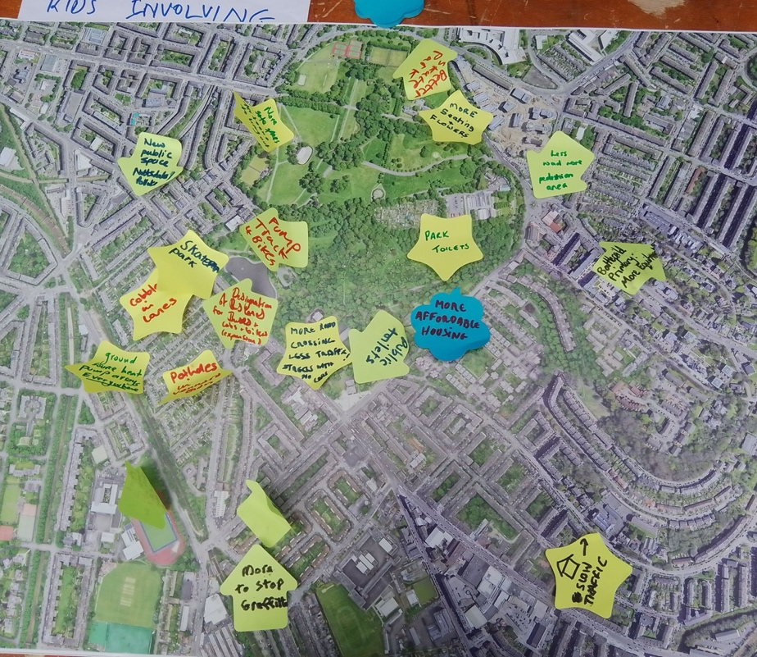
School Workshop with students at Shawlands Academy

Slide 11
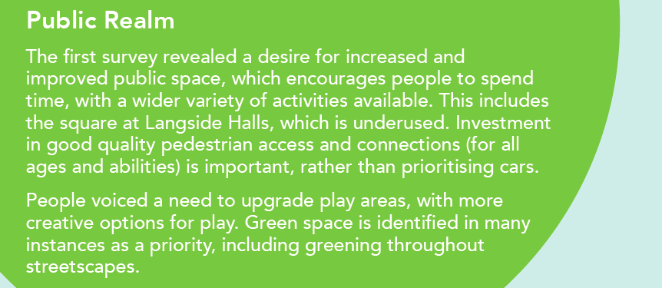

Slide 13
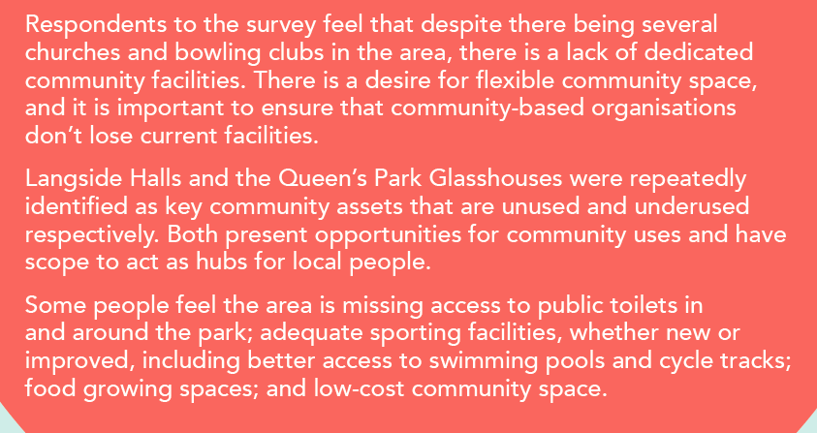

Slide 15
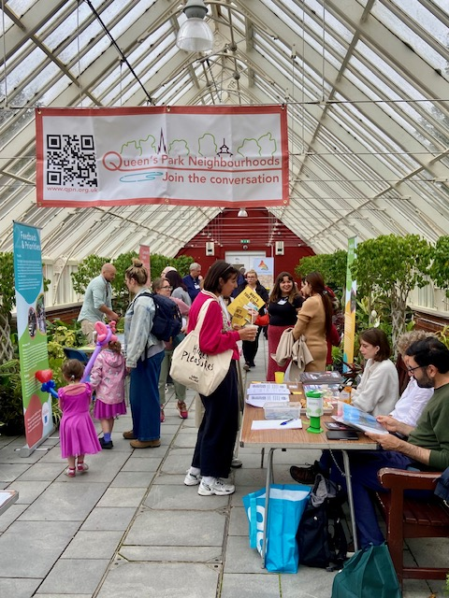
Consultation process
Stage 2
September – November
Stakeholder engagement
Online survey, promoted at cafés, shops, libraries, in the press and on social media
– 164 responses (as at 7/11)
Community drop-ins – Langside Library, Shawlands Festive Fayre

Slide 16
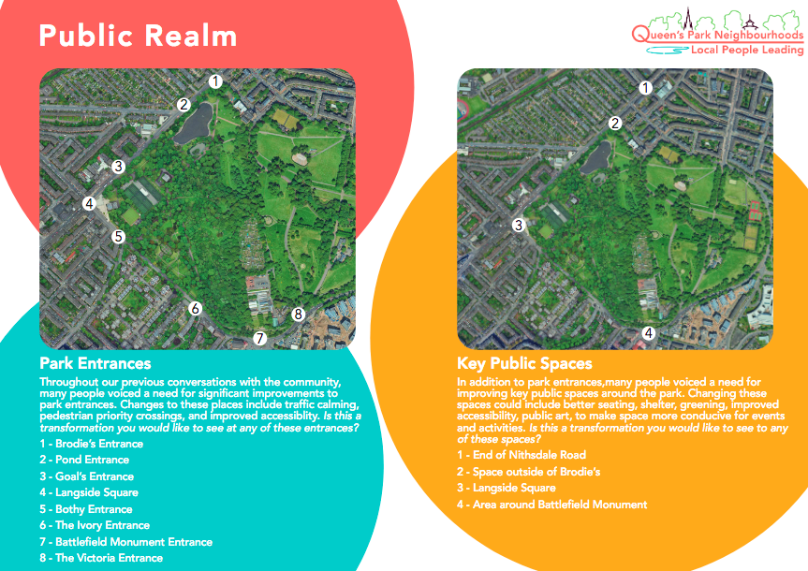

Slide 17
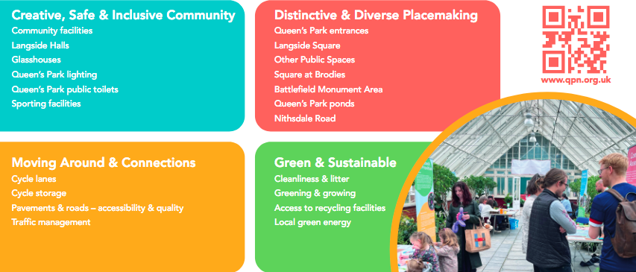

Slide 18
Vision
In 5- 10 years, Queen’s Park Neighbourhoods will be a forward-looking, strong community that is sustainable, accessible and cared-for, with excellent public buildings, spaces and activities for all.

Slide 19
Next steps
Stage 2 survey closes end-November
KMA prepare Stage 2 report – including specific projects to include in LPP
Stakeholder workshop on 15 January
Community drop-in event in February
Stakeholder engagement of QPN legacy
Legacy projects defined
Local Place Plan completed by end-March 2025

Slide 20
Any questions?

